Slide 1
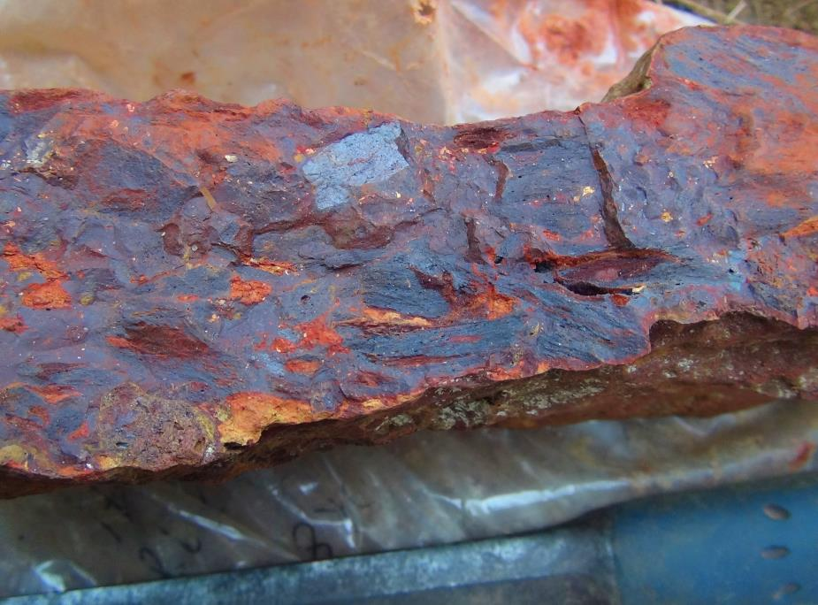
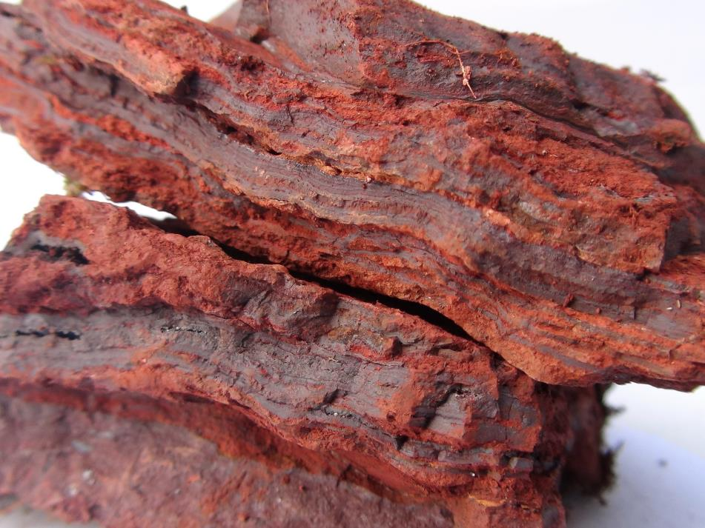
An Emerging African Iron Ore Giant
October 2013
Republic of Gabon

Slide 2
Disclaimer
This presentation has been prepared by IronRidge Resources Limited (IronRidge).
This presentation is not a prospectus, disclosure document or offering document under Australian law or under any other law. It is for informational purposes only.
Any material used in this presentation is only an overview and summary of certain data selected by the management of IronRidge. The presentation does not purport to contain all the information that a prospective investor may require in evaluating a possible investment in IronRidge nor does it contain all the information which would be required in a disclosure document prepared in accordance with the requirements of the Corporations Act and should not be used in isolation as a basis to invest in IronRidge. Recipients of this presentation must make their own independent investigations, consideration and evaluation of IronRidge. IronRidge recommends that potential investors consult their professional advisor/s as an investment in IronRidge is considered to be speculative in nature.
Statements in this presentation are made only as of the date of this presentation unless otherwise stated and the information in this presentation remains subject to change without notice. Reliance should not be placed on information or opinions contained in this presentation.
To the maximum extent permitted by law, IronRidge disclaims any responsibility to inform any recipient of this presentation on any matter that subsequently comes to its notice which may affect any of the information contained in this document and presentation and undertakes no obligation to provide any additional or updated information whether as a result of new information, future events or results or otherwise.
No representation or warranty, express or implied, is made as to the fairness, accuracy, completeness or correctness of the information, opinions or conclusions contained in or derived from this presentation or any omission from this presentation or of any other written or oral information or opinions provided now or in the future to any person.
To the maximum extent permitted by law, neither IronRidge nor, any affiliates, related bodies corporate and their respective officers, directors, employees, advisors and agents (Relevant Parties), nor any other person, accepts any liability as to or in relation to the accuracy or completeness of the information, statements, opinions or matters (express or implied) arising out of, contained in or derived from this presentation or any omission from this presentation or of any other written or oral information or opinions provided now or in the future to any person.
This presentation contains certain “forward-looking statements”. The words “expect”, “should”, “could”, “may”, “predict”, “outlook”, “guidance”, “plan” and other similar expressions are intended to identify forward-looking statements. Indications of, and guidance on, future earnings and financial position and performance are also forward-looking statements. Such forward-looking statements are not guarantees of future performance and involve known and unknown risks, uncertainties and other factors, many of which are beyond the control of IronRidge and the Relevant Parties, that may cause actual results to differ materially from those predicted or implied by any forward-looking statements. IronRidge makes no representations as to the accuracy or completeness of any such statement of projections or that any projections will be achieved and there can be no assurance that any projections are attainable or will be realized or that actual outcomes will not differ materially from any forward-looking statements.
The information in this Presentation that relates to Target Resources is based on information compiled by Mr Nicholas Mather. Mr Mather is a Member of the AusIMM and is a Director of IronRidge. Mr Mather has sufficient experience which is relevant to the type of deposit under consideration and to the activity he is undertaking to qualify as a Competent Person as defined in the 2004 Edition of the Australasian Code for Reporting of Exploration Results, Mineral Resources and Ore Reserves. Mr Mather consents to the inclusion in the Presentation of the matters based on his information in the form and context in which it appears.

Slide 3
Emerging World Class High Grade Iron Ore Province Close to
Deep Water Port
100% Ownership by IronRidge Resources Limited
Pro-mining government, transparent mining and exploration regime
Low sovereign, political and social risks
New province – Extensive tenure, 4000km² plus additional 1400km² under application
Exclusive exploration licenses for 3 years, followed by 2 extensions of 3 years
High grade DSO potential
Close to infrastructure, <70km from the deep water port of Mayumba
Highly Diagnostic Falcon gravity and Magnetic data highlights the targets
Accomplished management and exploration team
Global growth/urbanisation to drive iron ore market
Aggressive 2014 Program
Underwritten Raising proposed
5000m drilling program
Secure rail/port access – Gabonese Government’s $14Bn Infrastructure Plan
Resource Targets - Tchibanga & Belinga Sud targeting 1.2 billion tonnes
Location | Target | Strike Length (km) | Width (m) | Depth (m) | Specific Gravity | Fe% | Exploration Target (Mt) | Contained Fe (Mt)
Tchibanga | Mont Pele | 10.0 | 500 | 50 | 4 | 60 | 1000 | 600
Belinga Sud | Indombo | 6.0 | 300 | 50 | 4 | 60 | 360 | 216
Belinga Sud | Indombo South | 5.0 | 400 | 50 | 4 | 60 | 400 | 240
Belinga Sud | Massaha | 10.0 | 200 | 50 | 40 | 60 | 400 | 240
 |  |  |  |  |  |  |  | 1296

Slide 4
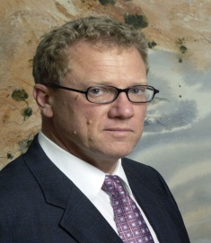
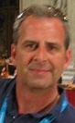

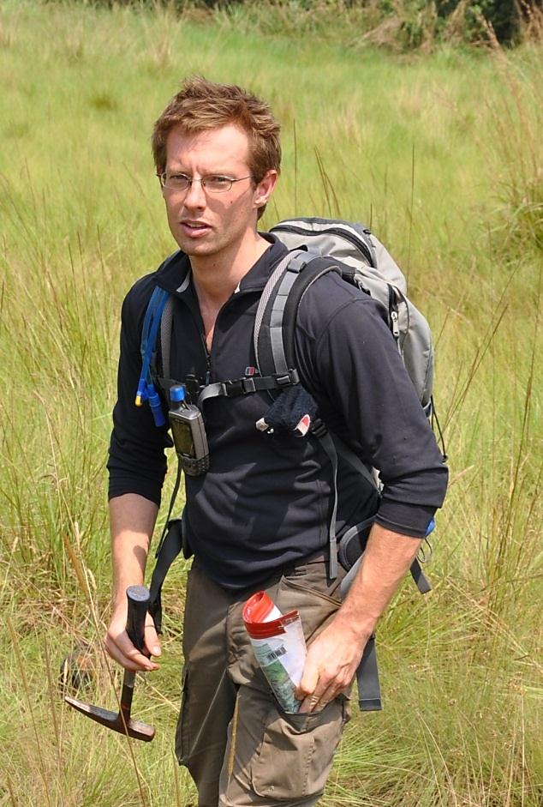
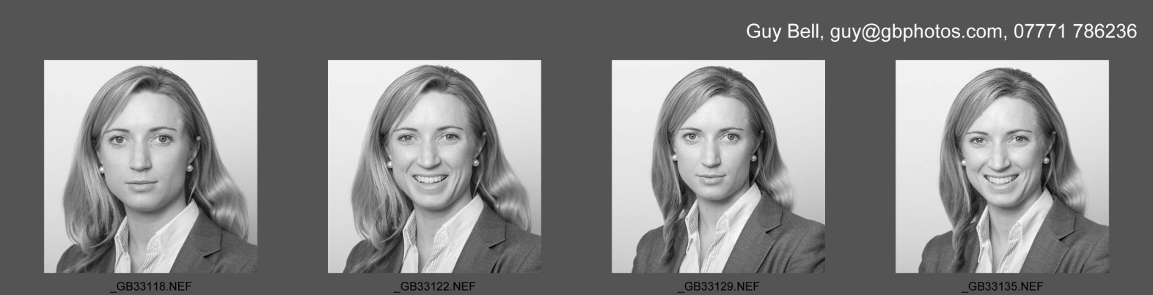
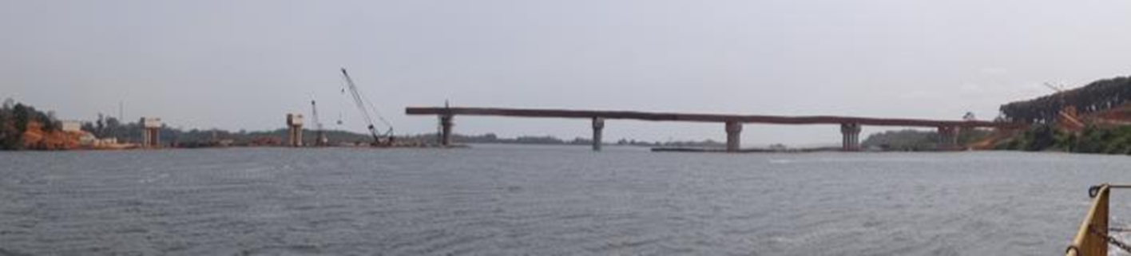
Accomplished Management
Directors
Nick Mather: instrumental in $4.8 billion shareholder growth, 6 takeovers
Vincent Mascolo: developed $600 million of major infrastructure projects on time and budget
Stuart Crow: track record in corporate finance, extensive knowledge of capital markets, fund raising IPOs and investor relations in Australia, Asia, London and Canada.
Management
Barry Stoffell (Chief Geologist - Africa): Formerly 1 of 5 New Opportunity Generators for Rio Tinto, experience in Africa and the Middle East
Amanda Geard (Business Development / Geologist): Formerly New Opportunity Generation and Management with Rio Tinto, experience in the Pilbara, Africa and the Middle East
July 2013 - Bridge to Mayumba Port, two spans left to complete the main structure

Slide 5
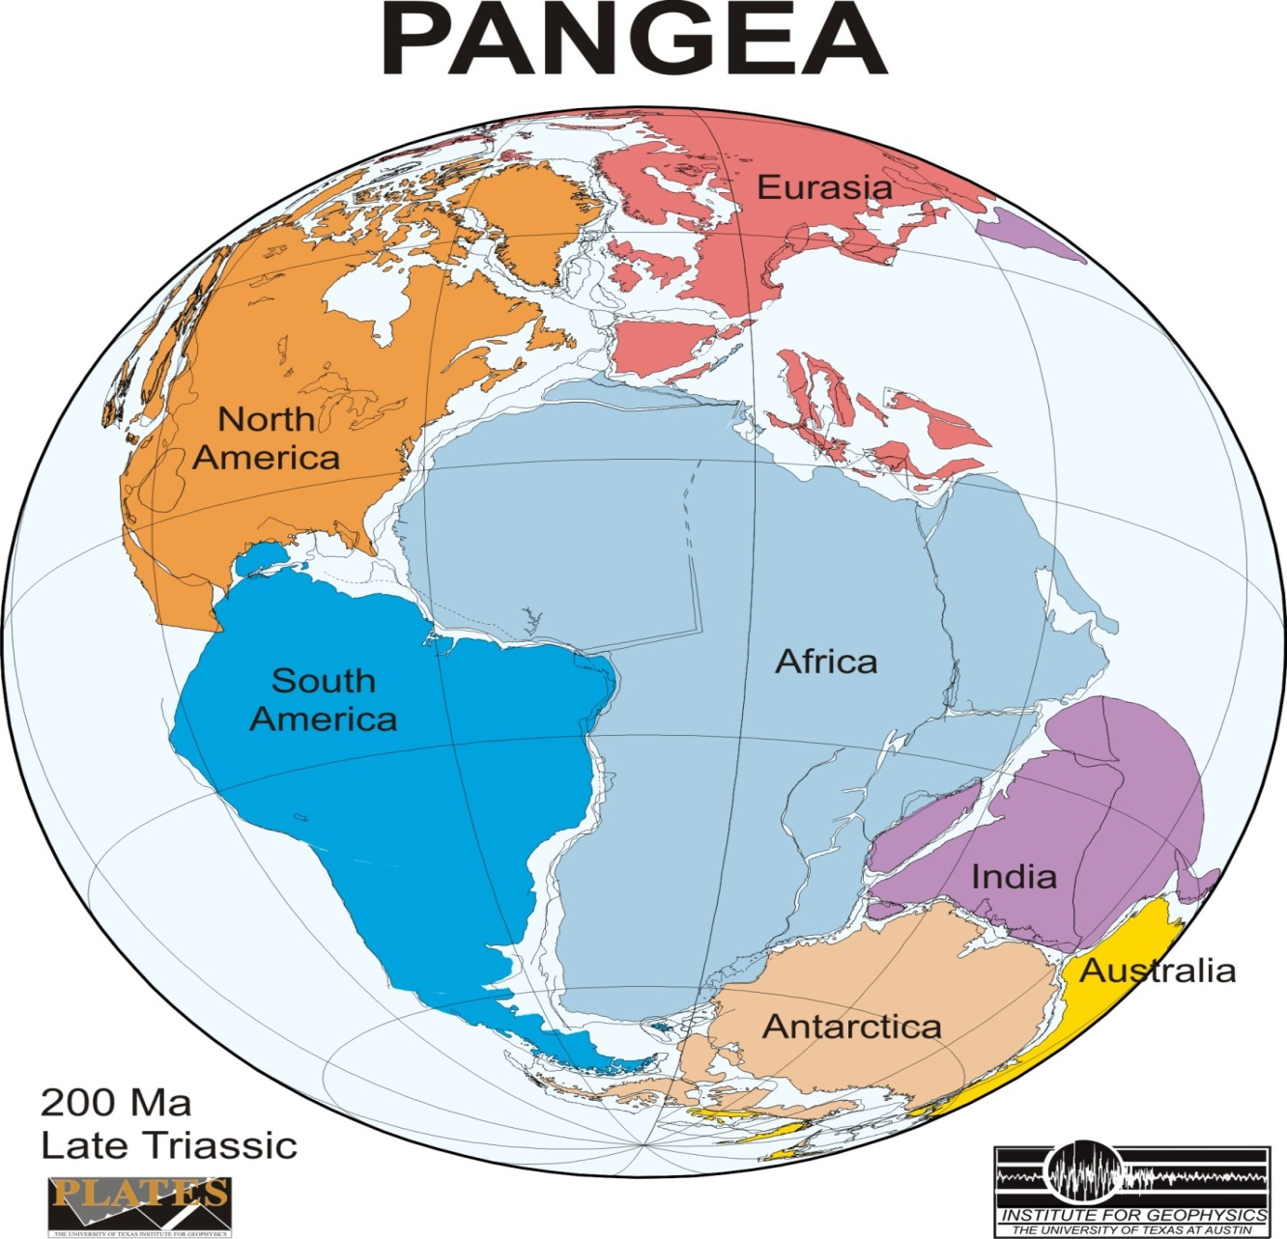
A New Iron Ore Province – 100% Ownership
PANGEA - Pre continental plate break up
Arrangement of the continents in the late Triassic (200Ma)
Brazilian structure was the other half
Tropical environment leaches and enriches the Iron rich sediments and removes impurities
West African Nations
Infrastructure development focus will open resource development
Iron ore market capitalisation of juniors is < 2% of the Pilbara
Gabon
Carajas
Carajas and West/Central Africa share similar geologic/climatic environment
Source: University of Texas Institute of Geophysics UTIG

Slide 6
Corporate Overview – 100% ownership
Capital Structure
Issued Share Capital | 128.5m
Options | 15.0m
Belinga Sud
Country | Gabon
Tenure | Granted PR
Area | 1976km²
Major Shareholders
DGR Global Limited | 46%
Board & Management | 14%
Tenstar Trading Limited | 8%
Top 20 Shareholders | 72%
Directors and Management
Nick Mather | Executive Chairman
Vincent Mascolo | Executive Director
Stuart Crow | Non-Executive Director
Barry Stoffell | Chief Geologist
Amanda Geard | BGM / Geologist
Karl Schlobohm | Company Secretary
Priy Jayasuriya | Chief Financial Officer
Tchibanga
Country | Gabon
Tenure | Granted PR
Area | 1977km²
Tchibanga
Country | Gabon
Tenure | Application PR
Area | 1400km²

Slide 7
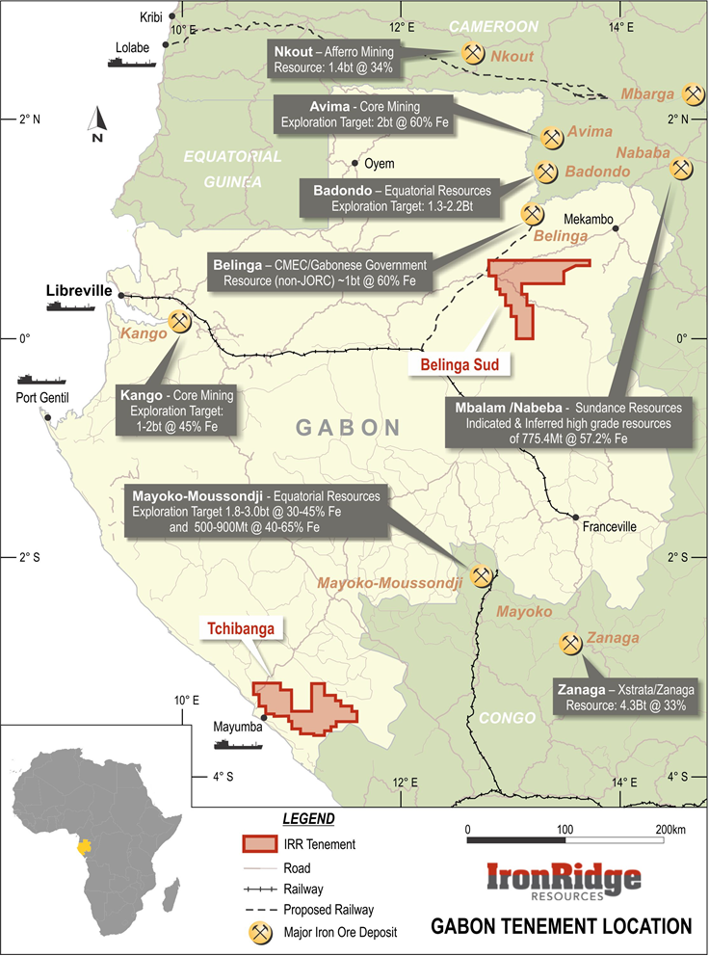

Gabon – Iron Rich, Supportive Government – Infrastructure
Region highly prospective for iron ore – supported by presence of majors (Ivanhoe Glencore and Rio Tinto)
Gabonese Government proactively diversifying export revenues away from oil
Trans-Gabonese Railway, Franceville to Port Owendo only 50% utilised, 5mtpa spare capacity
Gabonese Government’s recent announcement to invest $14.4 billion in transport infrastructure including 255km rail extension from Booue to Belinga
Government plan to double power generation capacity, including the development of a hydropower station at Booue
Mayumba Port Infrastructure works commenced Roads to be completed Q1 2014
Mayumba Port Bridge to be completed 2014
Transparent mining and exploration regime
POTENTIAL INFRASTRUCTURE CORRIDOR
Booue

Slide 8
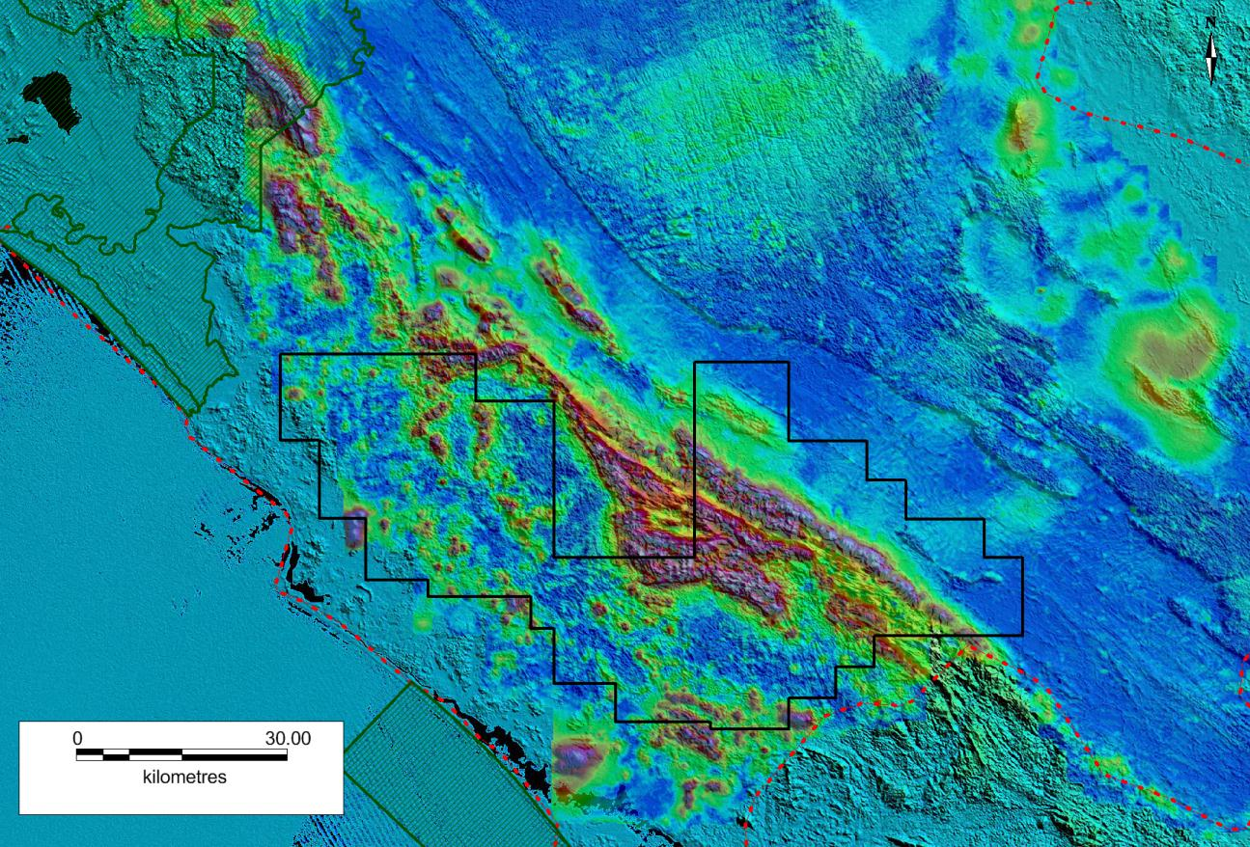
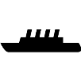
Tchibanga – High Grade Iron Potential, <70km to Port
Preliminary Interpretation
Recently acquired Falcon Gravity Data, cost saving of $900k
Based on “new” data, additional 1400km²application. 100% Gravity coverage.
Strong magnetic & Gravity response, similar to Milingui
Current sampling and mapping further confirms a correlation of the characteristic signatures provided by magnetics, gravity and topography data.
Preliminary Field Work
Confirmation of BIF and hematite
Grades up to 62% Fe Preliminary Exploration Targets 600Mt (conservative at10km strike length but potential for more)
Established relationship with key local stakeholders
Milingui Resources @180Mt
(National Park)
Mont Pele
>40km strike potential
Hematite Schists
Mayumba Port
BRGM / Sysmin Fe-occurrence
Infrastructure underway
Road to Tchibanga scheduled to be completed Q1 2014
Bridge to Mayumba Port scheduled to be completed 2014
Location | Strike Length (km) | Width (m) | Depth (m) | Specific Gavity | Fe% | Exploration Target (Mt) | Contained Fe (Mt)
Mont Pele | 10.0 | 500 | 50 | 4 | 60 | 1000 | 600

Slide 9
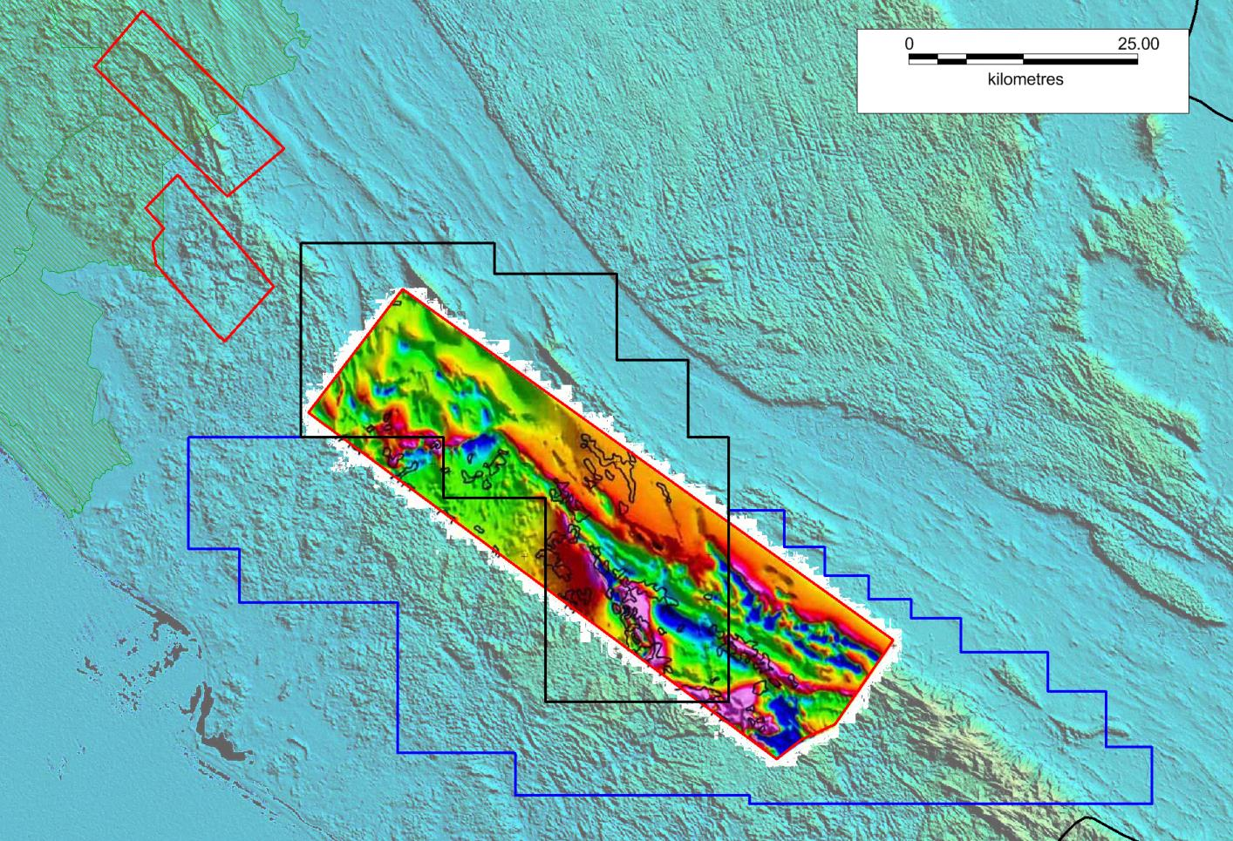
Tchibanga – New Application and Falcon Gravity Data
Coverage (100%)
Milingui Resources (Non JORC)@180Mt
(National Park)
A
IRONRIDGE GABON – NEW APPLICATION: 1,400km²
B
C
Huge downstrike potential in identical geological setting
IRONRIDGE GABON
TCHIBANGA PERMIT
1,977km²

Slide 10
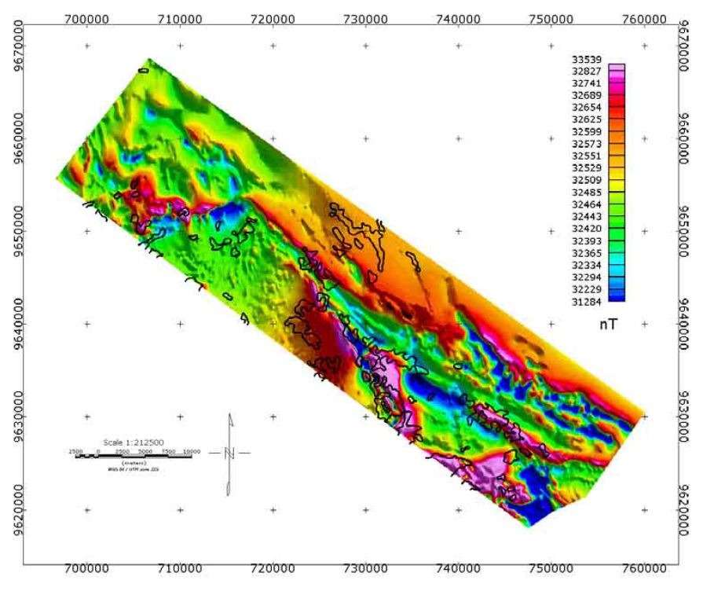
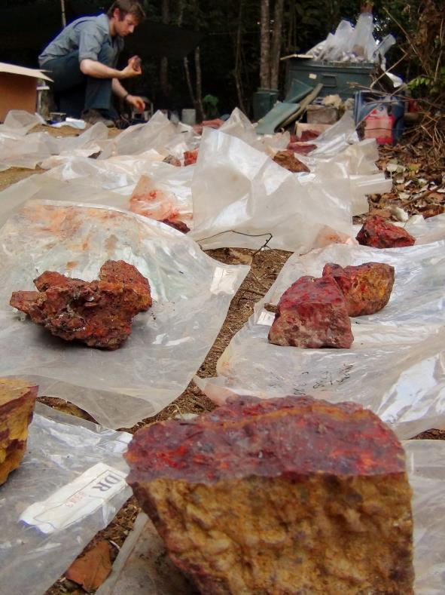
Tchibanga – Target Zones
Magnetic & Gravity Data Correlation
Target Zones within
IRR Tchibanga permit
10km
Target Zones within new
IRR application – Tchibanga Nord
Colour image shows magnetic intensity: gravity anomalies are outlined in black

Slide 11
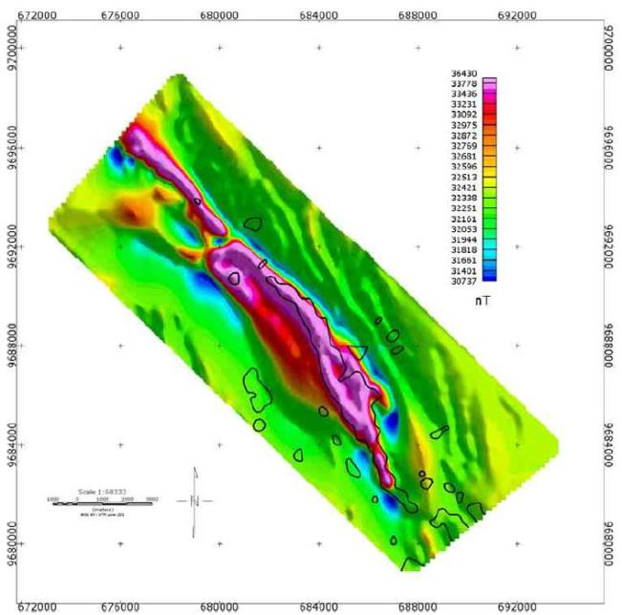
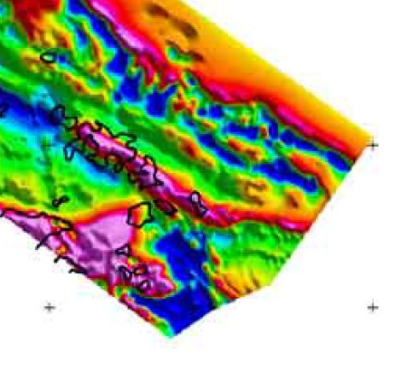
Tchibanga – Identical Gravity & Magnetic Signatures
Minlingui <70km NW along strike from Tchibanga
MILINGUI: 180Mt
TCHIBANGA: 1Bt + ?
5km
12km
Strong coincident response of Mag+Grav over known mineralisation at Milingui (Loukoula Grp)
Downstrike at Tchibanga, Mag+Grav maps the Fe-bearing Loukoula Grp with great accuracy
Segmented gravity response suggests ridge-perpendicular faulting, permitting fluid access to greater depth
Note the scale – IRR permit covers >40km of prospective strike, soon to be 85km

Slide 12
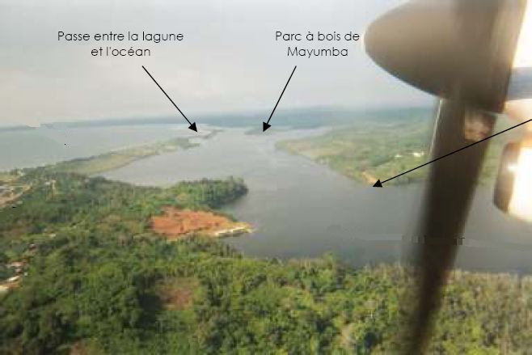
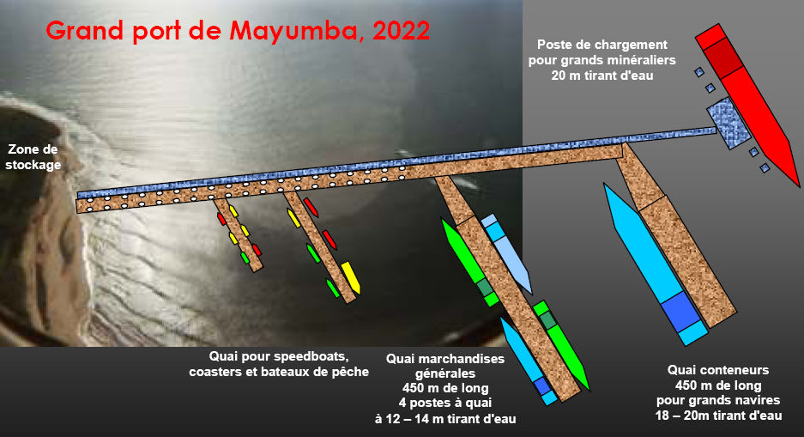

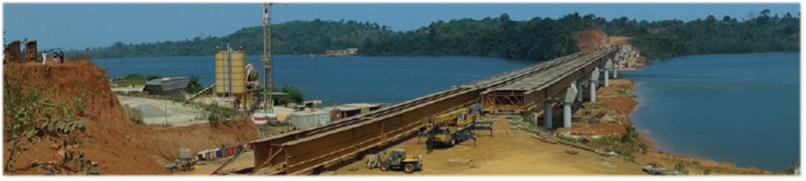
Tchibanga - Coastal Infrastructure
Proposed Port of Mayumba
Mayumba port inlet

Slide 13
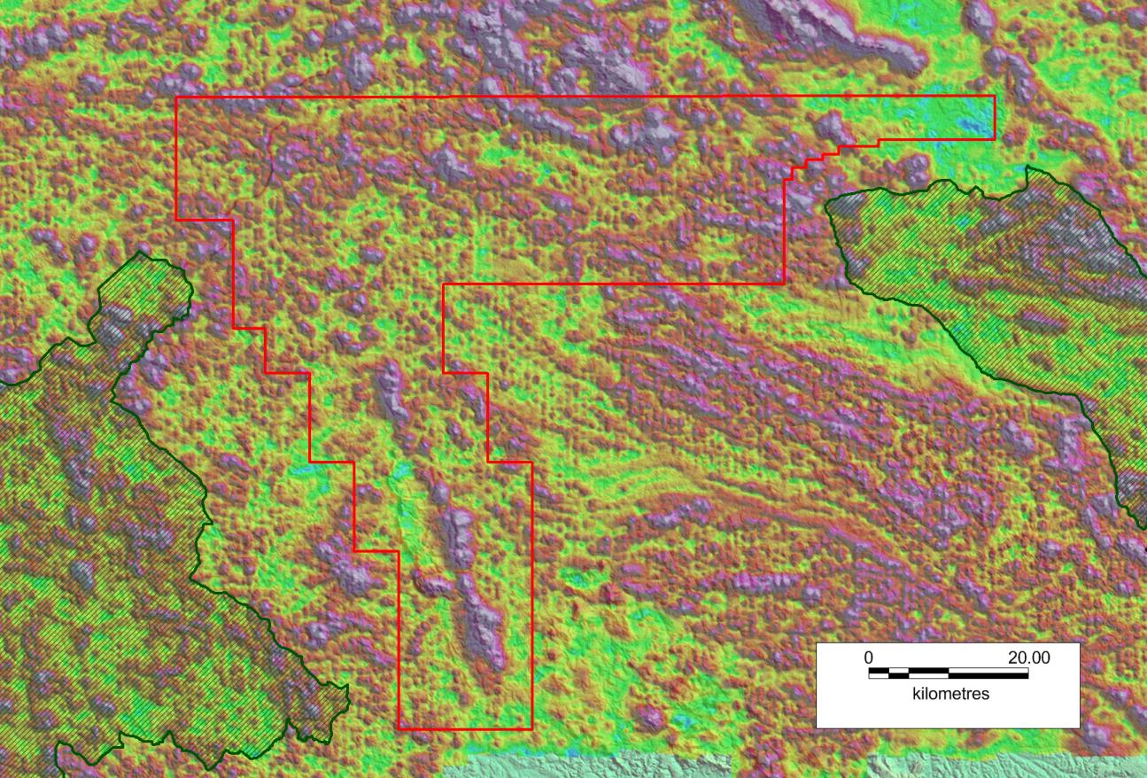
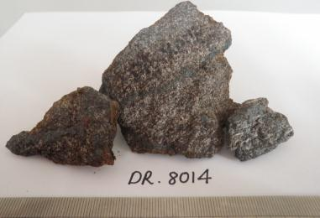
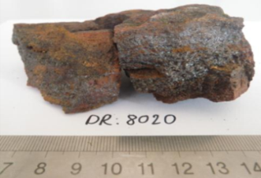
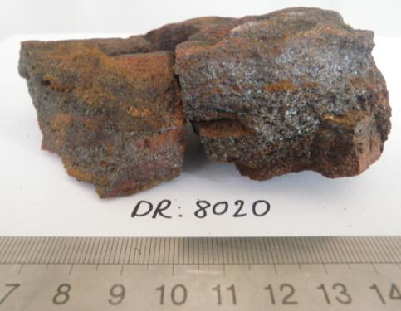
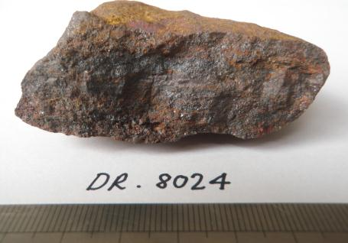
Belinga Sud – magnetic anomalies = high grade iron, extensive targets
Belinga Sud Tenure
Belinga Project (Non JORC Resources – 1Bt @ 60%Fe)
Massaha Target
27 km Strike potential
~60m height above plateau
e
27km
Makokou Target
Indombo Central
>6 km Strike Potential
~100m height above plateau
42km
ADR_8014: 39.4% Fe
ADR_8020: 66.8% Fe
ADR 8020: 66.78% Fe
Indombo South
5 km Strike Potential
ADR_8024: 62.4% Fe
BRGM / Sysmin Fe-occurrence
Magnetic image (Analytic Signal) over Belinga Sud tenure area showing high responses of proposed iron formations and extension of prospective geology to the south

Slide 14
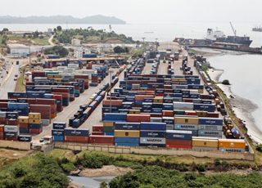
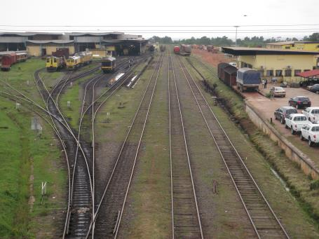
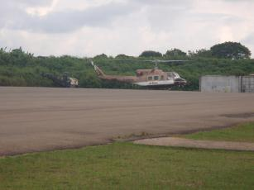
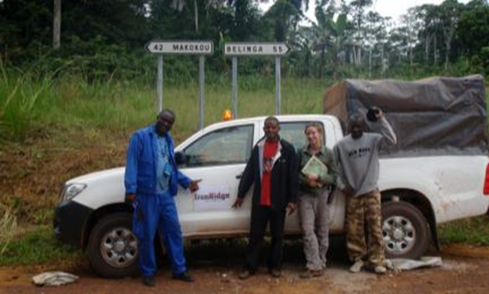
Belinga Sud - Infrastructure
Libreville Port
Owendo Rail Depot (SETRAG), Libreville
Makokou Airport
Road to Belinga

Slide 15
Contacts
Vincent Mascolo (Executive Director)
+61 418 285 412
vmascolo@dgrglobal.com.au
Nick Mather (Executive Chairman)
+61 7 3303 0680
nmather@dgrglobal.com.au
www.dgrglobal.com.au/ironridge

Slide 16
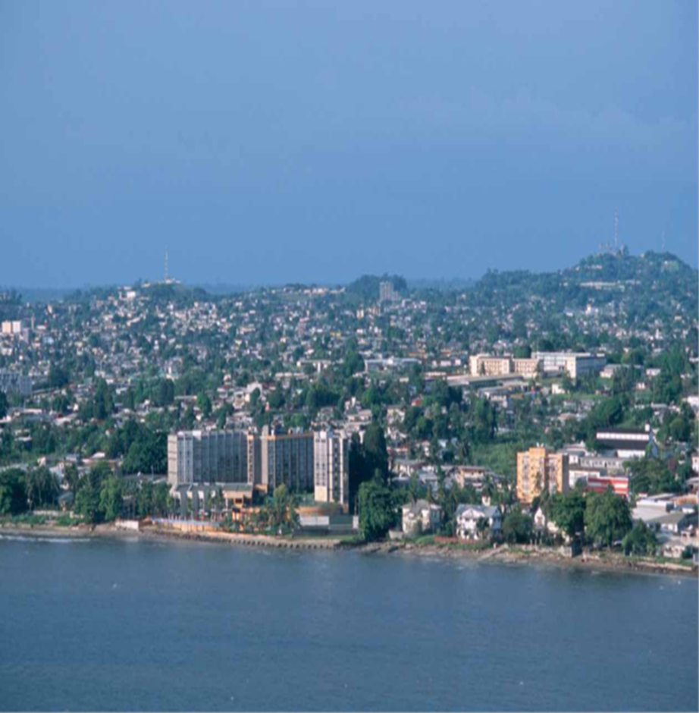
APPENDIX
Gabon Capital - Libreville

Slide 17
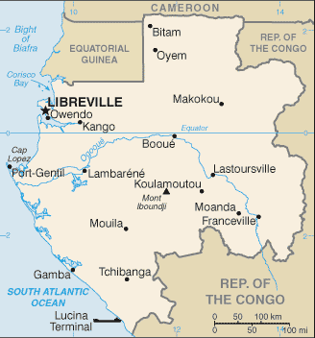
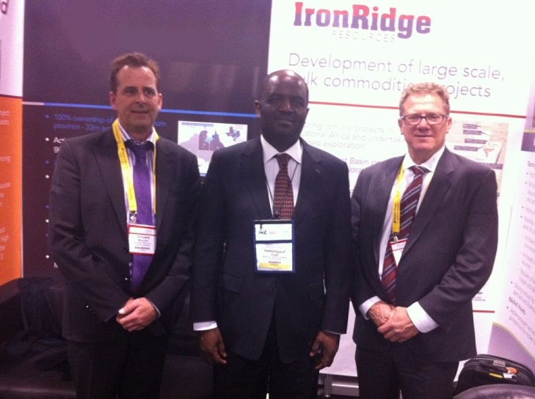
Gabon – Key Facts
Geography & Population
Area: 257,667km²
Population: 1.6M (ex CIA World Factbook)
Political
Republic, multiparty presidential regime
Economy (ex CIA World factbook)
GDP $24.3bn for 2011 (+5.3% YoY)
Key exports oil (70%), timber, manganese
Promoting diversification from oil
Exploration/Mining Tenure (Mining Code 2000)
Autorisation de Prospection (AP) - 2 year, preliminary exploration
Permis de Recherche (PR) - 3 year and 3 x 3 year extension, equivalent of EPM/EL
Mining Permit - 10 year & 5 year renewable
Regime of ad valorem royalty, no obligation for state ownership
IRR Directors with his Excellency Regis Immongault,
Minister of Industry and Mines of Gabon .
PDAC 2013

Slide 18
Population growth and urbanisation to drive steel demand for coming decades
The world is set to urbanise close to another 3 billion people by the middle
of the century
Source: Rio Tinto
Source: UN, McKinsey, Rio Tinto

Slide 19
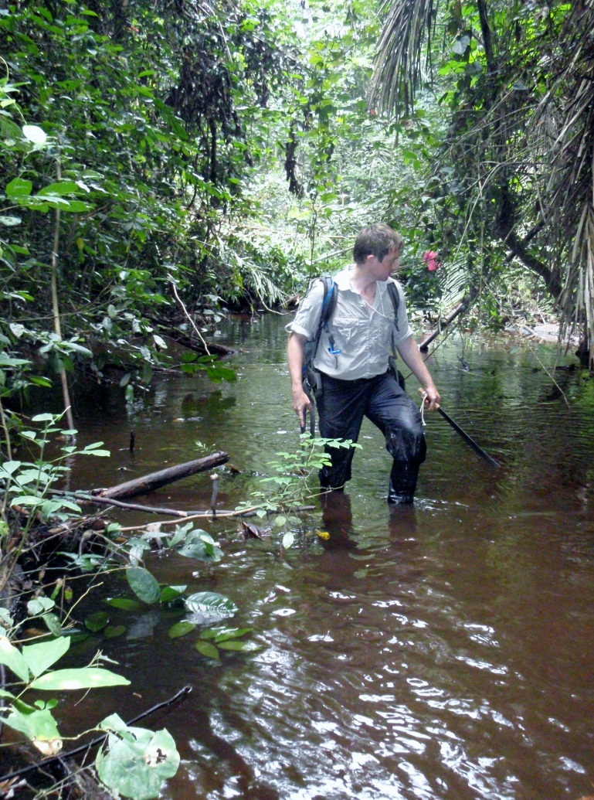
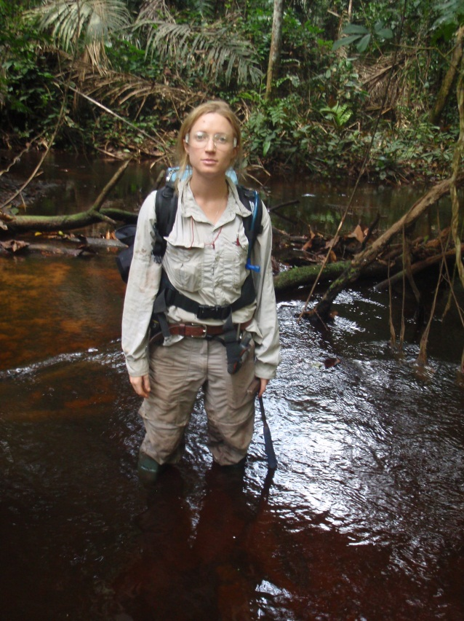

Reconnaissance Program
Program Summary
Permis de Recherche (PR) - awarded 28 June 2013
3 year x 3 year x 3 year extension without relinquishment
2nd Reconnaissance program commenced July 2013
Program objectives
Engage key stakeholders
Audit of local facilities
Evaluate access to target areas
Mapping & sampling to confirm extent of Fe-rich material
Program at Belinga completed July 2012, Tchibanga completed August 2013
Geophysical Surveys currently underway
Barry Stoffell
Amanda Geard
Road to Belinga Sud

Slide 20
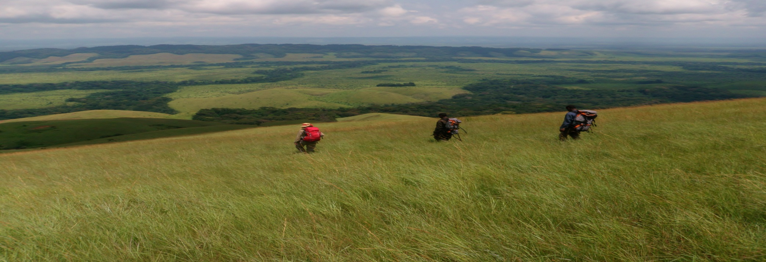
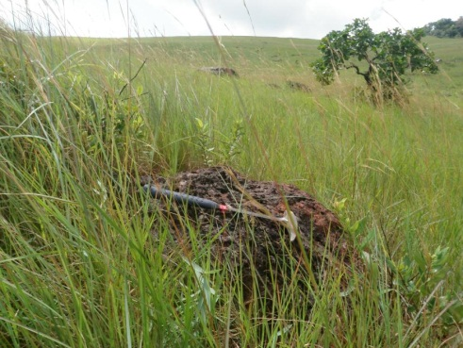
Reconnaissance at Tchibanga 2013
Mont Pele range
1 Bt Hematite iron ore targets
100% owned in a new province, <70km to the deep water port of Mayumba

Slide 21
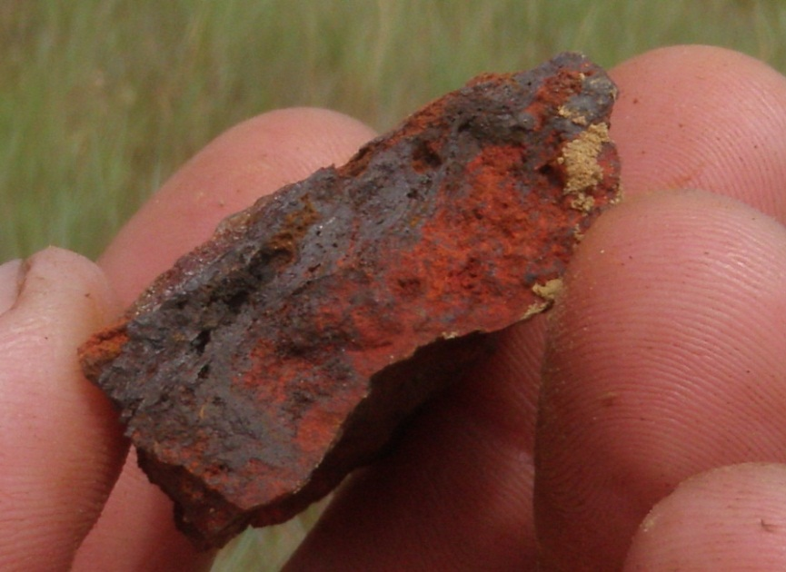
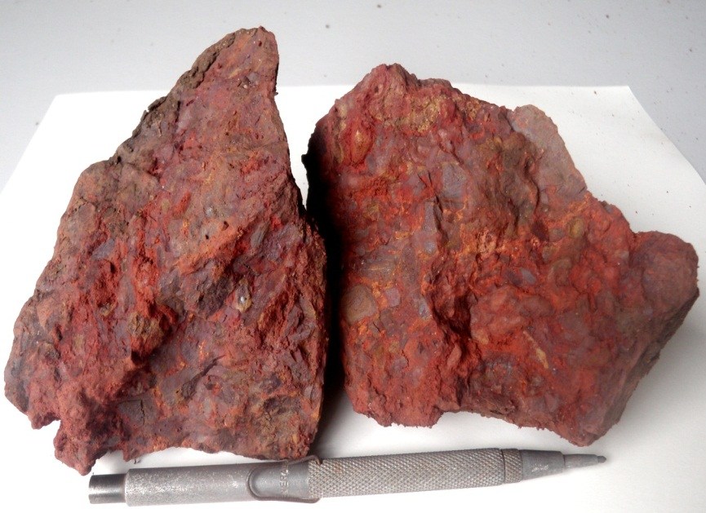
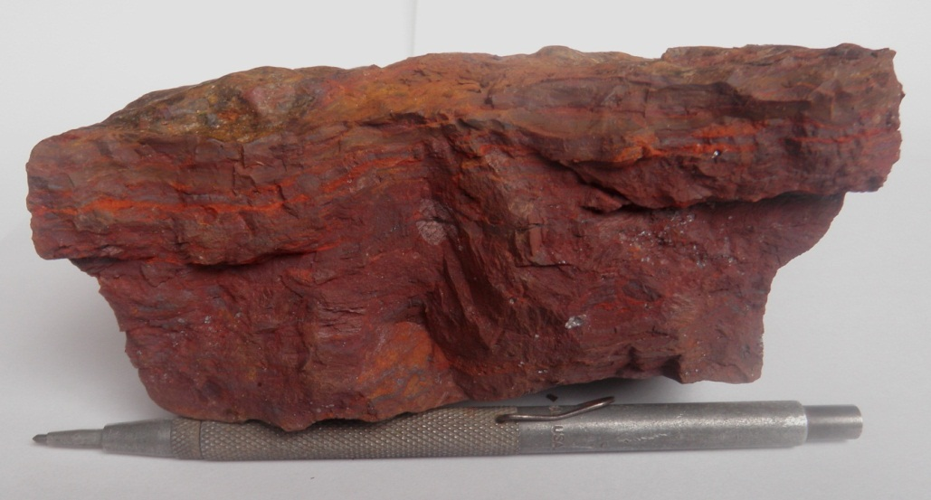
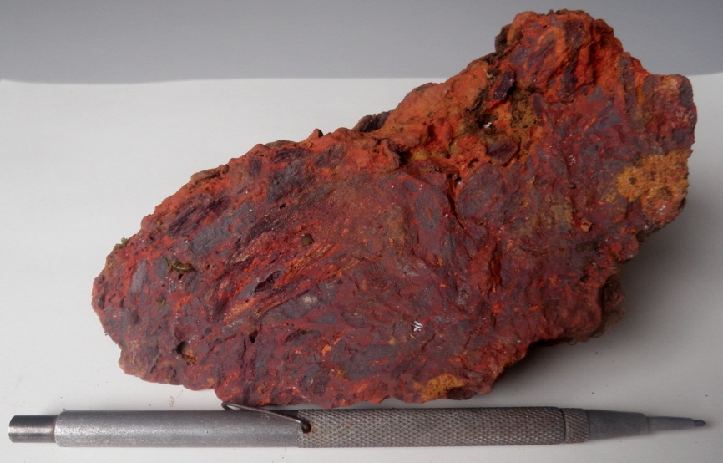
Key Results from Tchibanga Reconnaissance
60.62% Fe
55.44% Fe
48.86% Fe
49.49% Fe

Slide 22
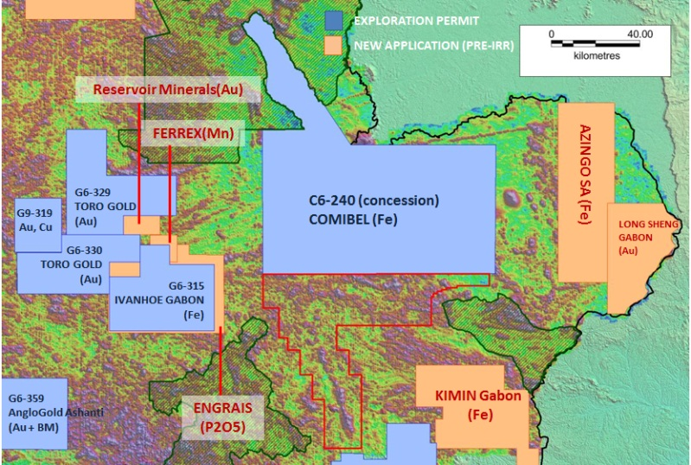
Belinga Sud
BELINGA SUD
IRONRIDGE (Fe)

Slide 23
Value Proposition – Large Scale
Post Exploration Desktop Financial Cashflows: Tchibanga & Belinga Sud
(Large Scale Operations)
 |  | Tchibanga | Belinga Sud
Resource / Grade |  | 200mt @60%Fe 800mt @50%Fe | 200mt @60%Fe 800mt @50%Fe
Iron Ore Price |  | US$100 | US$100
ROM |  | 35mtpa | 5mtpa – 10mtpa - 35mtpa
CAPEX |  | $1.990b | $4.27b
IRR |  | 148.5% | 39%
OPEX (Sold)/t |  | $41.49 | $48.77
NPV (10%) |  | $13.366b | $5.351b
EBITDA/yr average |  | $1.769b | $1.099b
Surplus Cashflow |  | $49.170b | $35.34b
ROM |  | 35mtpa | 5mtpa – 10mtpa - 35mtpa
Life of Mine |  | 29yrs | 30yrs
Project Life |  | 31yrs | 32yrs
Payback from COM |  | 1.25yrs | 4.1yrs
Mining Royalty :
3% to 5% ad Valorem
Corporate Tax Rate:
35%
Import Duties:
Do NOT apply during the exploration
and Investment phase
All consumables used during processing
are also excluded

Slide 24
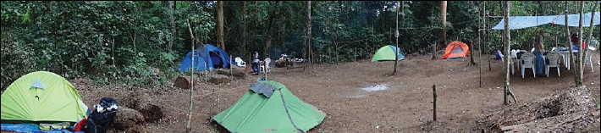
Value Proposition – Small Scale
Post Exploration Desktop Financial Cashflows: Tchibanga
(Small Operations utilising pre-loved plant and equipment)
 |  | Tchibanga | Tchibanga | Tchibanga
Resource / Grade |  | 25mt @60%Fe | 37.5mt @60%Fe | 50mt @60%Fe
Iron Ore Price |  | 1mtpa | 1.5mtpa | 2mtpa
ROM |  | US$100 | US$100 | US$100
CAPEX |  | $94.16m | $110.81m | $133.28m
IRR |  | 29.8% | 44.5% | 51.8%
OPEX (Sold)/t |  | $55.01 | $47.25 | $44.57
NPV (10%) |  | $186m | $392m | $574m
EBITDA/yr average |  | $38.87m | $68.3m | $95.79m
Surplus Cashflow |  | $848m | $1.567b | $2.226b
ROM |  | 1mtpa | 1.5mtpa | 2mtpa
Life of Mine |  | 25yrs | 25yrs | 25yrs
Project Life |  | 26.5yrs | 26.5yrs | 26.5yrs
Payback from COM |  | 3yrs | 2yrs | 1.7yrs
Mining Royalty : 3% to 5% ad Valorem , Corporate Tax Rate: 35%
Iron Ridge field camp, 2km east of Mont Pele, Tchibanga

Slide 25
Track record – 6 deals, $4.8b
Nick Mather, founder and Director of IronRidge Resources:
Company | $ | Role
Arrow Energy | 3,500m | Co-founder, Executive Director
Bow Energy | 500m | Co-Founder, Executive Director
Bemax | 350m | Managing Director
Waratah Coal | 130m | Co-founder, Chairman
Auralia | 25m | Managing Director
Ballarat Goldfields | 300m | Non-Executive Director

Slide 26
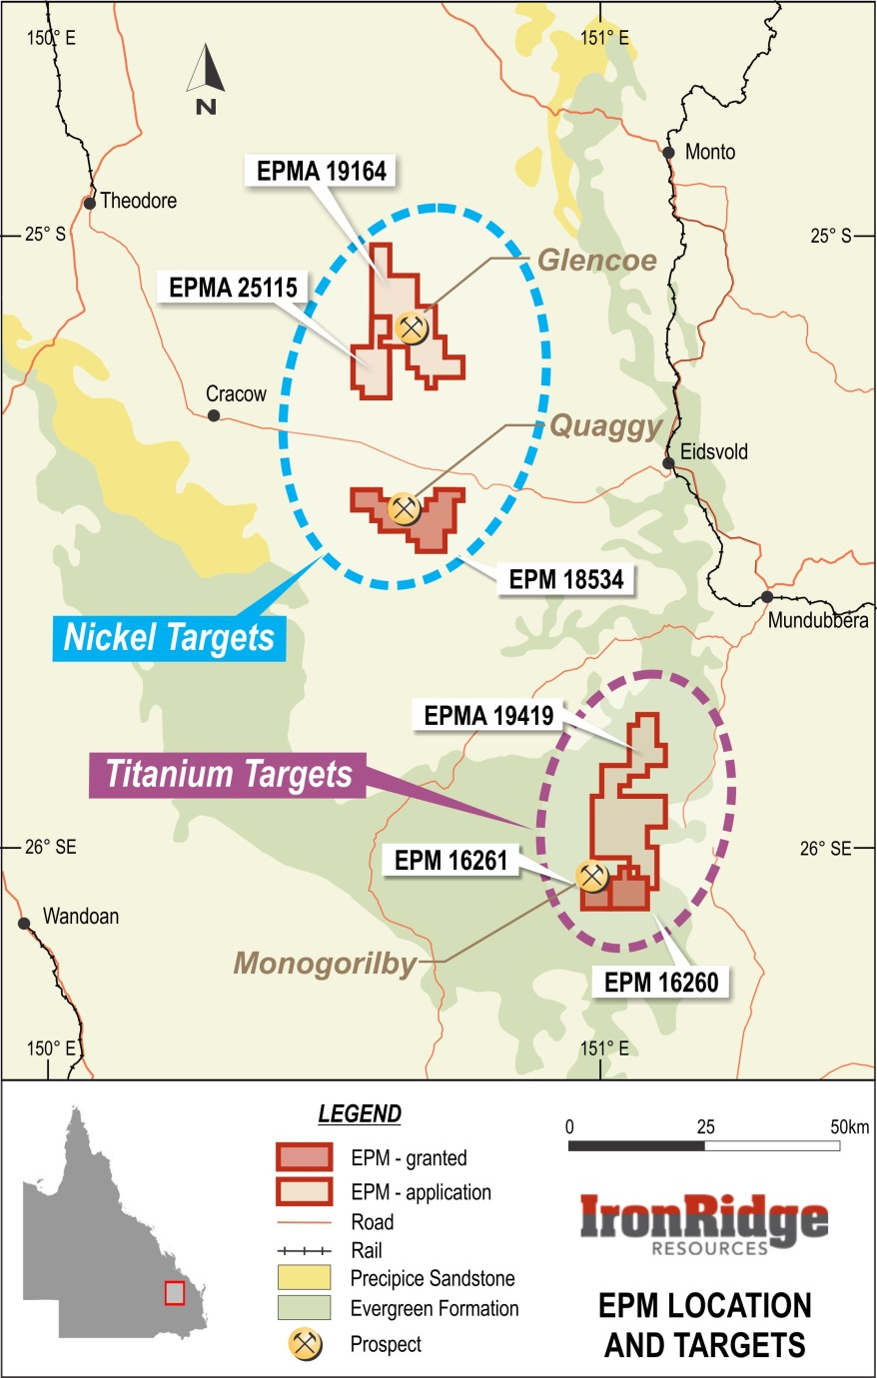
QLD Assets – World Class Titanium and Nickel Targets
Monogorilby - Titanium
Drilling undertaken 2013
Recent shallow auger drilling over 40km²
Resource Estimate (non-JORC) of 1.1bt @3.5%TiO₂
Metallurgical test work underway
Drilling undertaken late 2011
Top 11 metres average >4.5% and up to up to 13.8% TiO₂
Rutile panned from samples
XRD (X-Ray Diffraction) indicates rutile and ilmenite associated with goethite
Preliminary metallurgical results produced an intermediary product that may be suitable for hydrometallurgical processing
Quaggy and Glencoe - Nickel
Strong magnetic results indicating potential for major sulphides
Soil sampling results include >400ppm Ni & >400ppm Cu

Slide 27
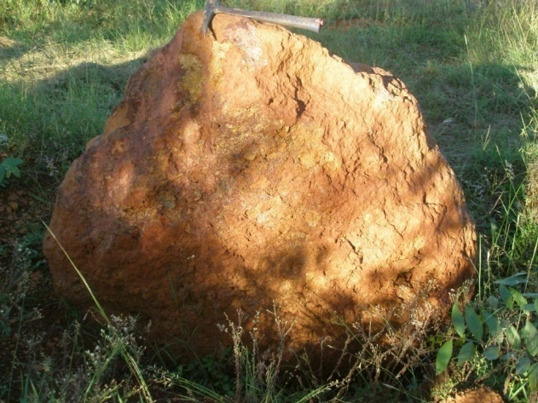
Monogorilby – World Class Titanium Targets
Maiden Resource Estimate
1.1bt @3.5%TiO2 (non -JORC)
Metallurgical test work underway
Hydro Metallurgy to separate Iron – Aluminium - Titanium
Titanium rich iron stone at Monogorilby - 31% TiO₂

Slide 28
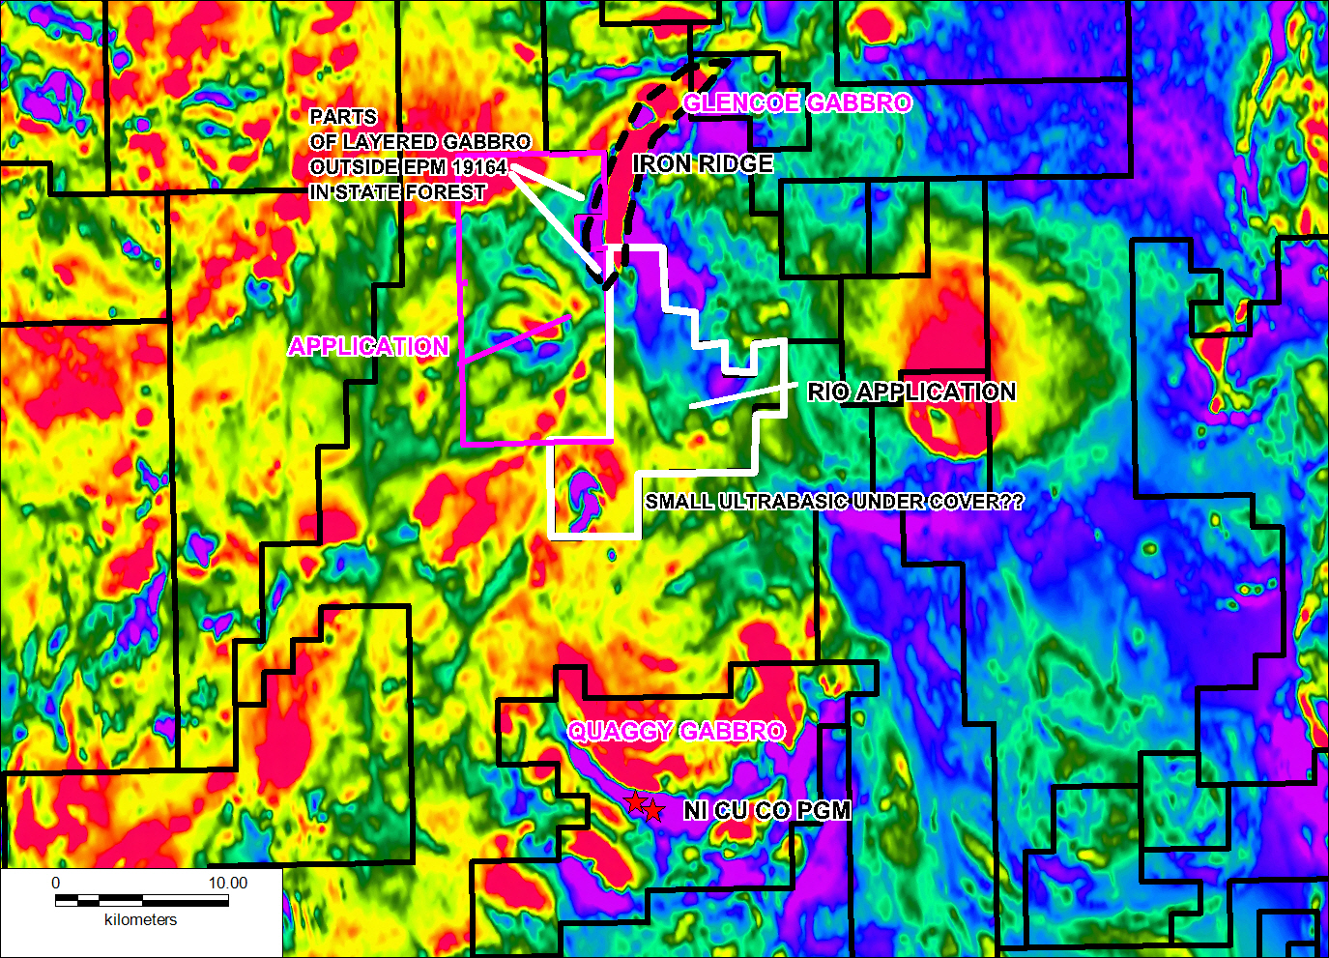
Quaggy and Glencoe – Potential Nickel Sulphide Belt
Full coverage of the layered gabbros – 30 km strike length
Gabbros are generally preferred hosts for major nickel deposits (eg Norilsk)
Rio Tinto recently secured EPM between Quaggy and Glencoe

Slide 29
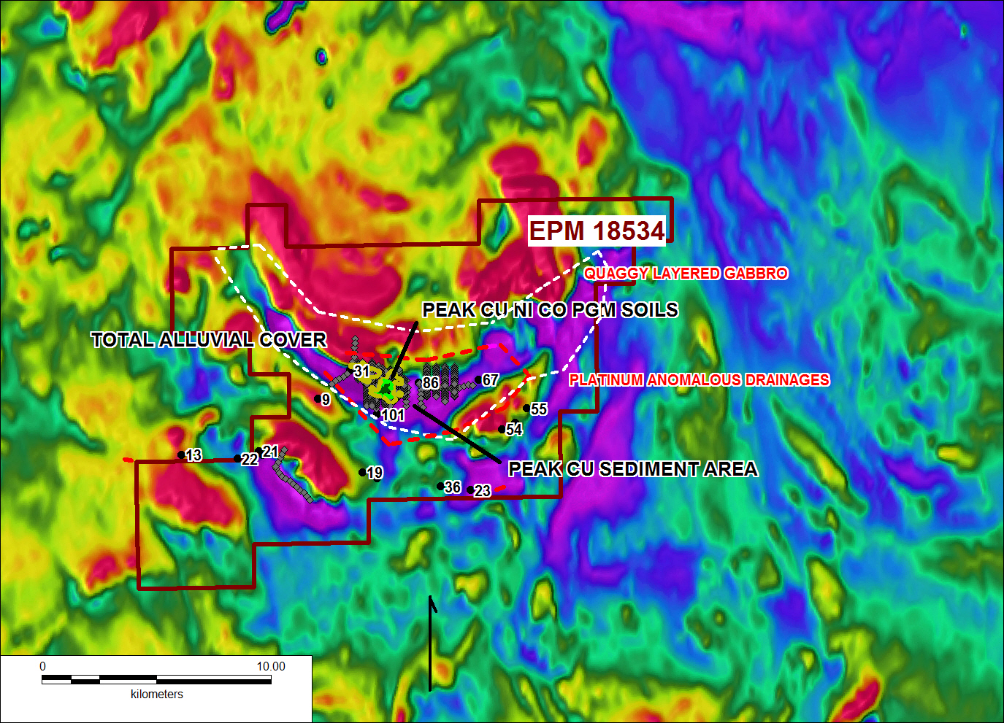
Quaggy – Coincident Mag and Geochem
Coincident magnetics and geochem (Pt, Pd, Ni) anomalism is indicative that the magnetotelluric conductors are due to a major metal sulphide deposit

Slide 30
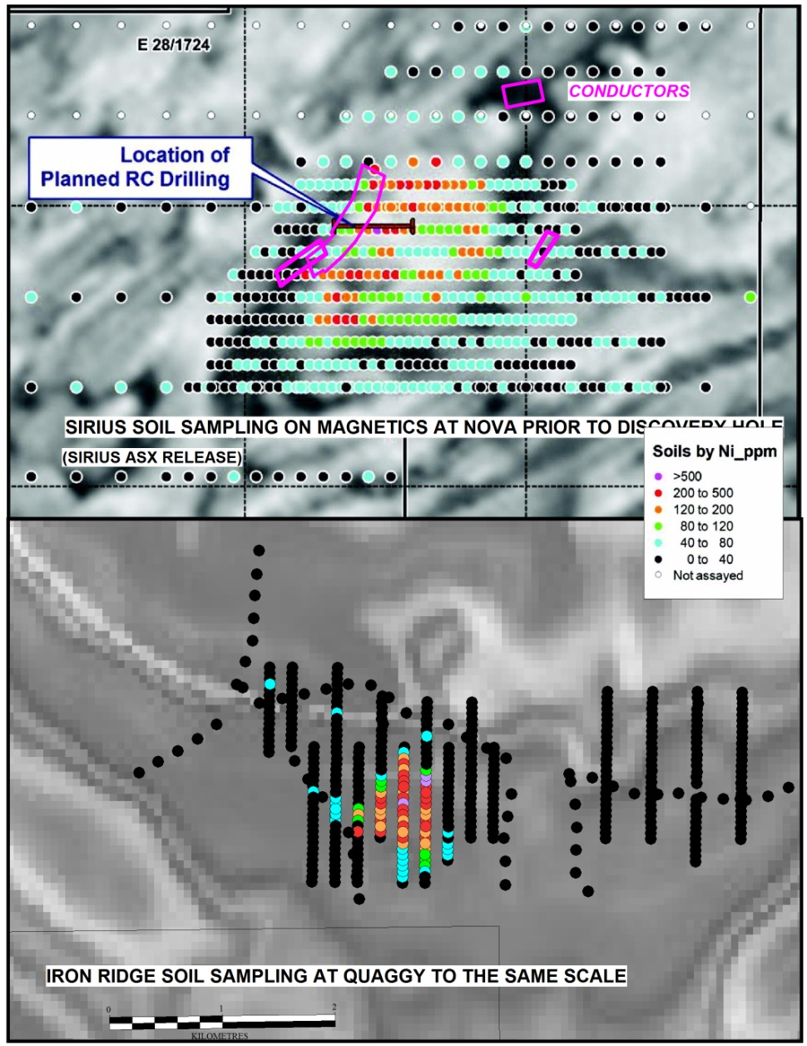
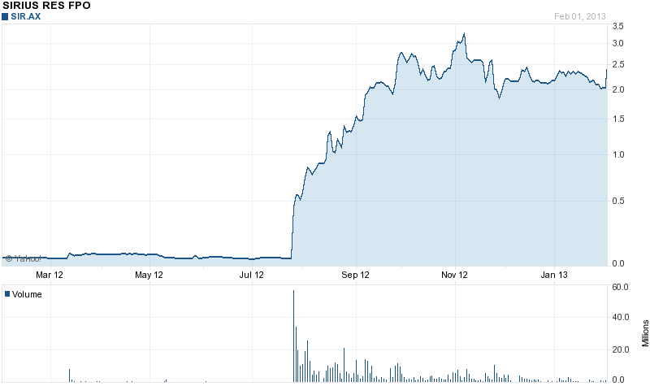
Quaggy – Potential Nova Style Target
Comparable in size and strength to the recent Nova discovery.
Western extensions may greatly increase the size at Quaggy - Norilsk is the same age ie Permo Triassic
Glencoe offers further potential nearby.
Nova discovery

